Slide 1

Pseudo-Constants in SQL
@RileyMajor

Slide 2
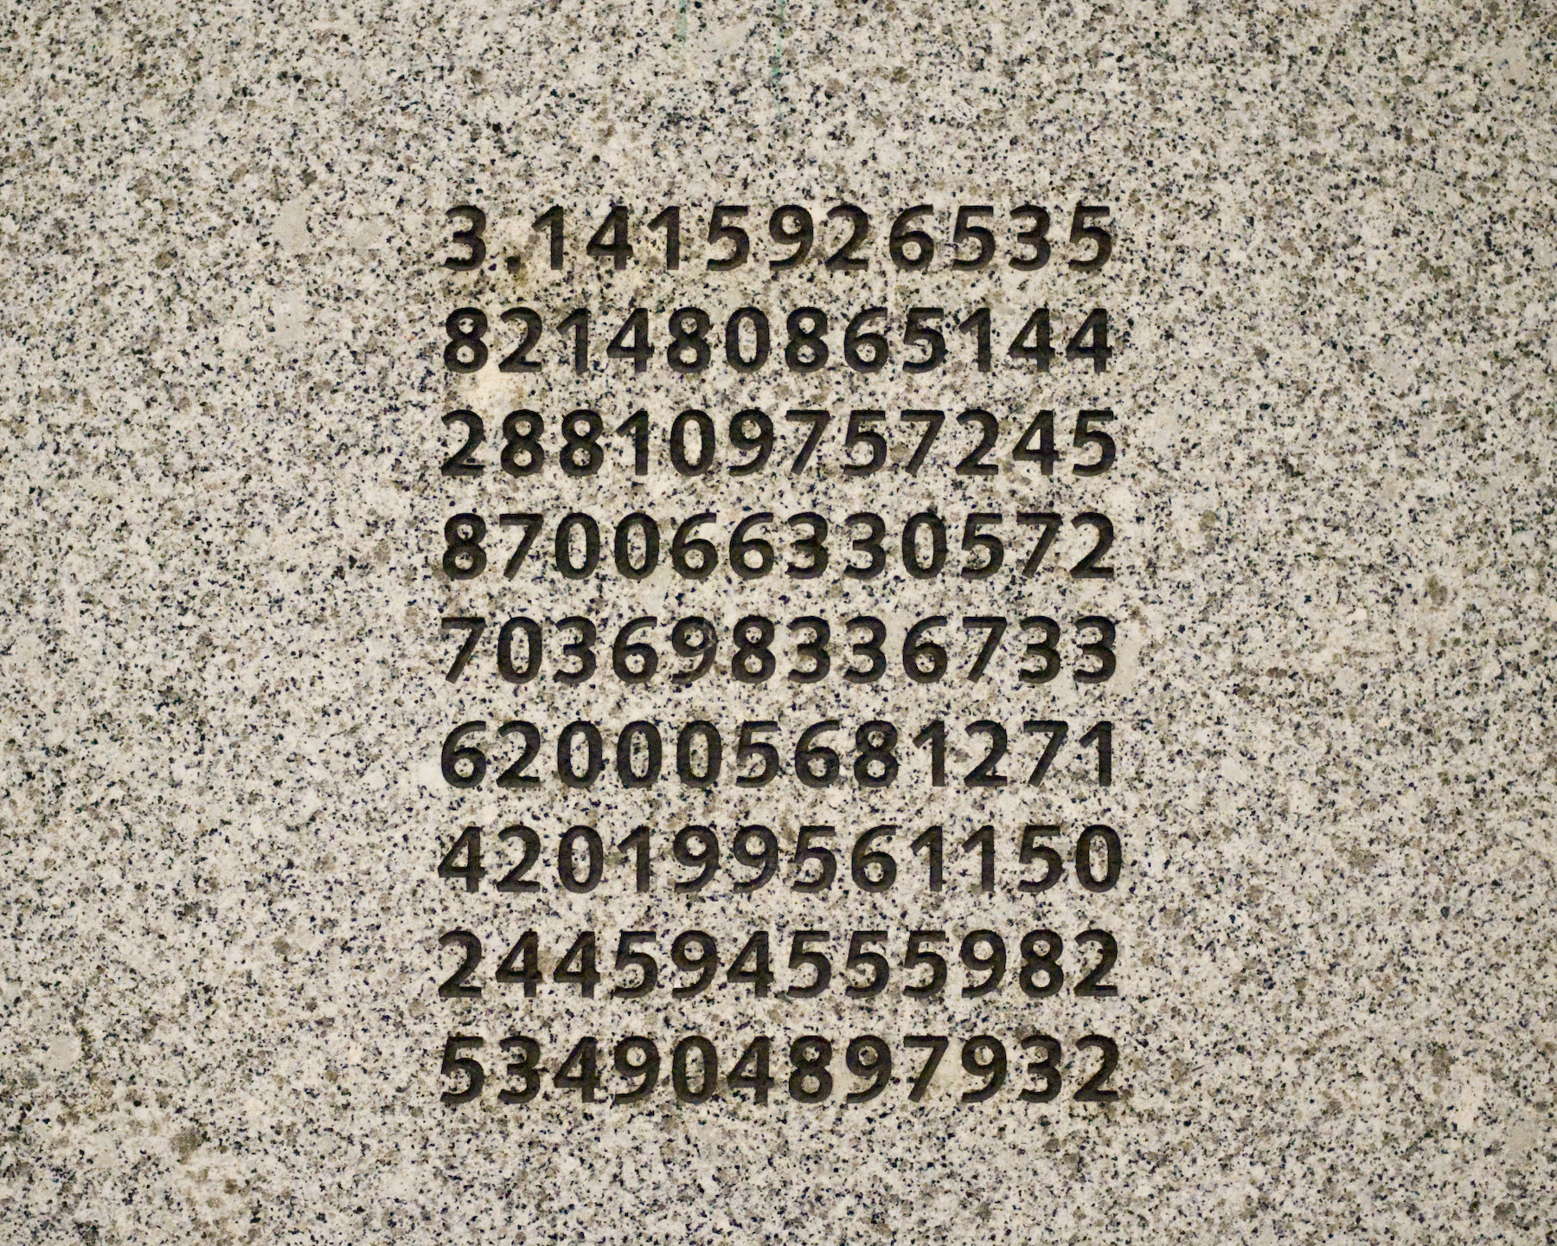
Pseudo-Constant Candidates
Infrequently Changed
Frequently Referenced
These digits are misleading.
http://en.wikipedia.org/wiki/Washington_Park_MAX_Station

Slide 3
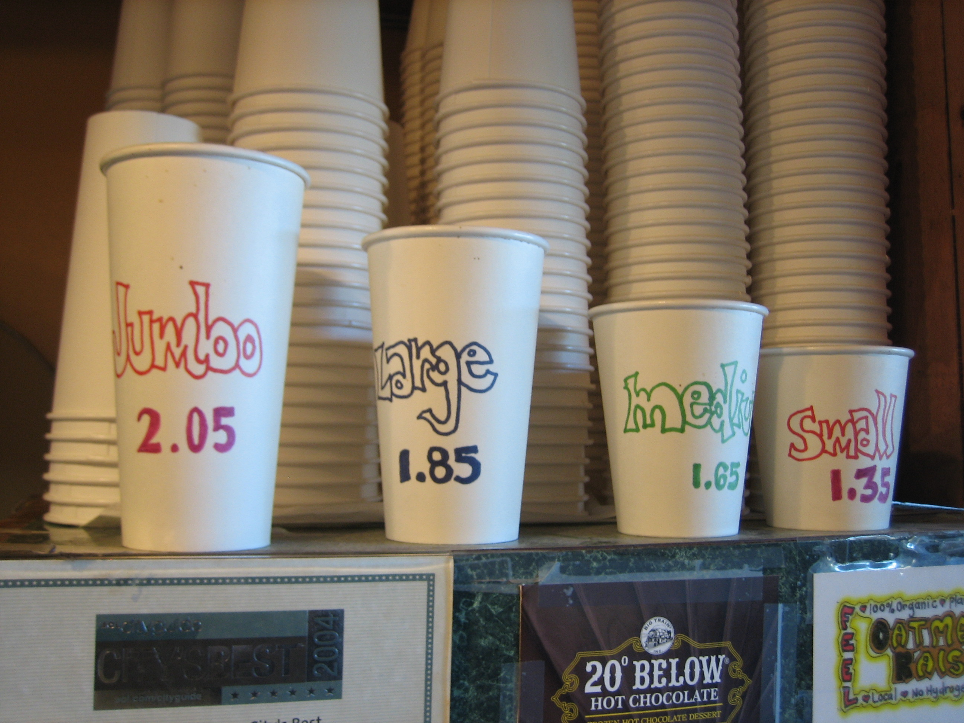
They’re everywhere…
Sizes
Order Statuses
DEFCON Levels
Notes:
Ask audience to come up with examples.
Reference Growing Pains episode where Mike worked at fast food restaurant with Colossal and “Woah” sizes.

Slide 4

Use Lookup Tables
Less Space
Better Performance
Cleaner Data
Numeric ID / Textual ID / Description

Slide 5

Magic
Numbers
Codes
Enums
Constants
IDs

Slide 6
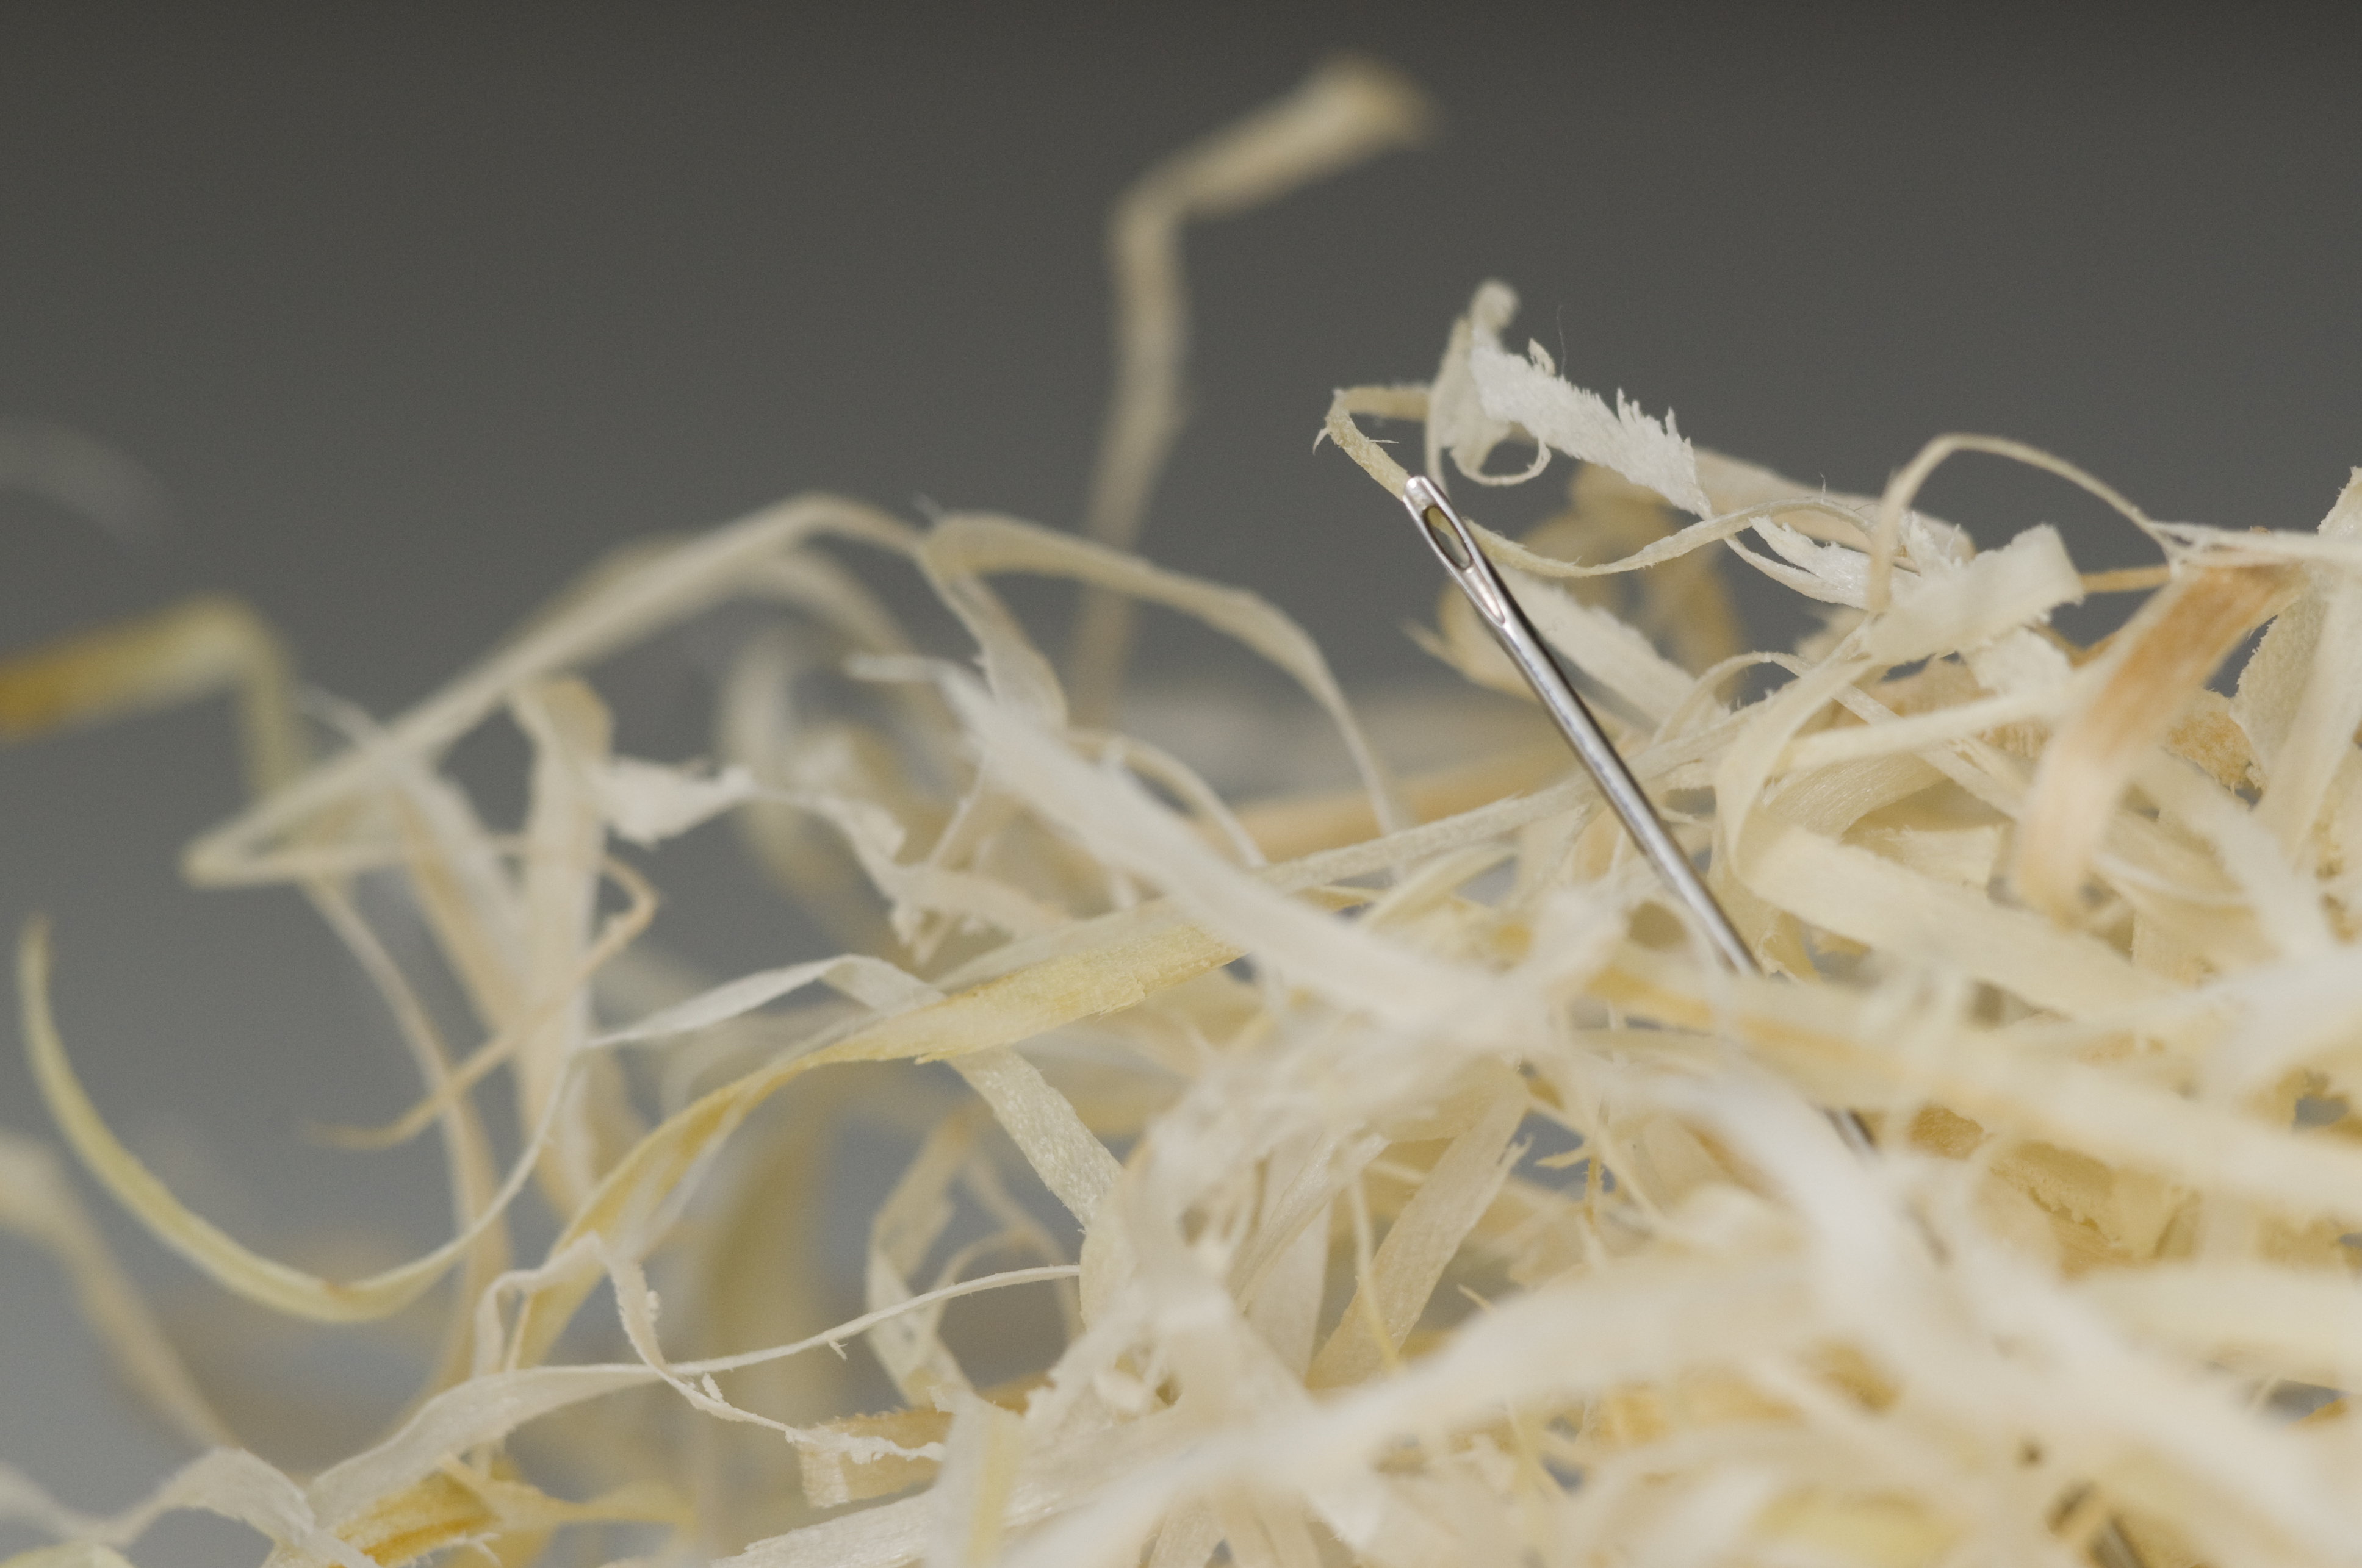
Traditional Option:
Hard Coding
Fast
Easy
Maintenance Nightmare
Did you find them all?

Slide 7

Better Option:
JOINs to Lookup Tables
Text Codes
Slightly Slower
More Complex Query Plans

Slide 8

Best Option:
Pseudo-Constant
Functions
Fast
Compiler Enforcement
IntelliSense

Slide 9


Riley Wheeler Major
@RileyMajor
RileyMajor.com
PASSMN@RileyMajor.com
www.linkedin.com/in/rileymajor/
Enterprise Architect
Manna Freight Systems, Inc.
http://www.MFSCorporate.com/

Slide 10

Rate this talk!
Pseudo-Constants in SQL
@RileyMajor
https://joind.in/12405

Slide 11
Photo Credits
Day 187: Tilt-Shift Miniature Fake
Snugg LePup
https://www.flickr.com/photos/snugglepup/3741073220
Pi
Benjamin Chan
https://www.flickr.com/photos/benchan/4771478057
IMG_8549
Tantek Çelik
https://www.flickr.com/photos/tantek/272706097
The Worlds Greatest Detective
Kit
https://www.flickr.com/photos/practicalowl/1185217331
No more rabbits?
Kristina Alexanderson
https://www.flickr.com/photos/kalexanderson/6163134201
Needle In A Haystack
t_buchtele
https://www.flickr.com/photos/t_buchtele/3422507814
DSP 87: Wagon Ride 2007-08-12
Vern Hart
https://www.flickr.com/photos/vernhart/1143920492
Very excited for cake
Sean Donohue
https://www.flickr.com/photos/hermida/608166432

Slide 12
Additional References:
SQL Saturday Link:
https://www.sqlsaturday.com/viewsession.aspx?sat=332&sessionid=25053
Misleading Engraved Pi Digits
http://www.o4sr.org/publications/pf_v4n3/PiUnderground.htm

